Slide 1
Presentation to BuildGreen Atlantic
Halifax, Nova Scotia, April 28, 2026
Copyright Gavin Pitchford © 2026
Numbers quoted overwhelmingly sourced from Statistics Canada and other Government of Canada sources. Some numbers in the “prism” slide borrow from industry reports (i.e. CaGBC / Delphi, 2026)
Individual slides may be replicated, provided credit is given. To replicate beyond a single slide, please first contact the author for written permission.

Slide 2

Getting here…

Slide 3

Identifying and Recognizing Leadership - Driving collaboration through connection…
16 years / 1000+ members / 1,000+ collaborations per Summit / 100 Awards per year

Slide 4
Questions of You…
How many of you are “Green Builders” because you make way more money and have gotten wealthy by building green?
How many motivated in large part because you care about the environment and humanity doing less to drive climate change?
How many folks here are founders, partners, owners or senior execs in their organization?

Slide 5
More questions for You…
Multiple Choice: WITHOUT GOOGLING! What Percentage of Canada’s GDP comes from the oil industry?
60%+
40-60 %
20-40 %
10-20 %
<10%
<5%

Slide 6
Canada’s “Clean Economy” Sectors Defined:
You might be a sector member if…
you do better when governments impose the true cost of externalities that industries presently “take” free from the environment, but which then impose a cost on all of us…
For example, if your business would do better when:
The cost of carbon pollution or energy consumption increases
The cost of water or waste increases
Protection for the environment increases
Climate action / transition / building community resilience to severe climate events are prioritized by government
full life cycle costs are included in government procurement (including energy use and end-of-life waste disposal in particular)

Slide 7
Still more questions for you…
Is the portion of Canada’s GDP from the “Clean Economy” more or less than the amount from the:
Steel Industry?
Aluminum Industry?
Automobile Industry?
Lumber Industry?
Housing Industry?
Non-Res Construction?
Mining Industry?
Oil Industry?
Clean Economy GDP ??
$4.2 | ~$7 | 23,000
$6.2 | ~10 | 13,800
$17. | ~30 | 130,000
~$32 | ~42 | 199,345
~$53 | ~80 |~ 650,000
~$80 | ~95 |~ 950,000
$112 | ~156 |~ 430,000
~$85 | ~207 |~ 150,000
~140 |~290 |~ 700,000+

Slide 8
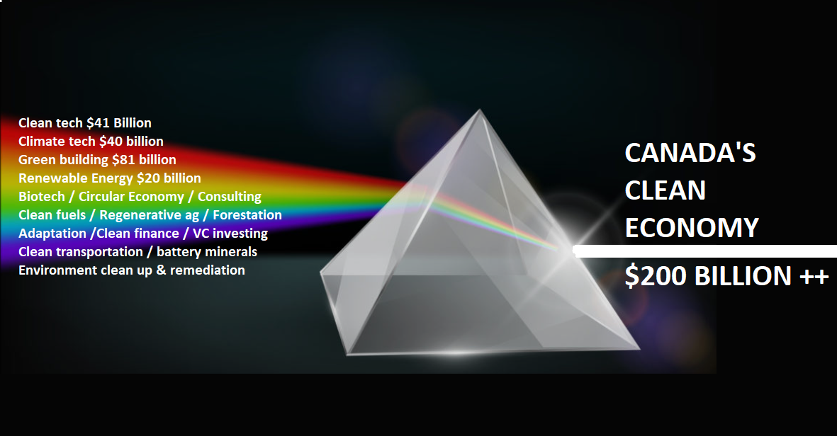

Slide 9
Fossil Fuel Industry in Canada
Per the IMF, we have the single most subsidized oil producers in the world – at $61 Billion per year, including costs borne by society (health, clean up, environmental damage etc.)
Per Environmental Defense – Average of $29 Billion per year (direct subsidies only i.e. payments + pipelines)
Average profits / annum last 5 years: $30 billion
Ownership: 56-75% non-Canadian → dividends / profits leave Canada
Revenue focused within 5 big companies / locations = heightened community impacts / our eggs in only a few baskets
Job decline: 2013: 215,000 | 2023: 177,000 | 2026: 150,000 Another 50,000 losses forecast lost by 2040. Already less than 1%.

Slide 10
Fossil Fuel Industry in Canada
Tied with Venezuela for “Dirtiest oil in the WORLD” award:
  the tar sands oil = filthy product can only be refined in one place – not gasoline. (Why our “oil” is priced below market).
  Difficult extraction consumes most energy in process (takes ~5 barrels to extract 10)
If Alberta were a country, would be the highest per-capita GHG emissions in the WORLD (Saskatchewan #3)
Confirmed clean up costs of un-capped abandoned wells: $190 Billion: Estimated +$70 more (expected hidden remediation)
  $260 B estimated total. Cleanup Funds in reserve: $1.6 Billion. Shortfall $258.4 (half annual federal budget)
  50% of existing wells expected to cease production by 2035

Slide 11
In this room, most of us agree: The “clean economy” is better than our existing, fossil fuel focused economy. Yes, it’s a low bar…
But… the fossil fuel industry won’t go quietly…
For us to prevail, we will need to do 2 things:
Counter decades worth of embedded biases and misinformation: The average Canadian believes the fossil fuel industry represents between 30 and 40% of our GDP.
Present an economic alternative Canadians can see as providing us continued prosperity.

Slide 12
They’re gonna fight back:
Misinformation and FUD (fear - uncertainty - doubt)
MYTH 1: Even just their calling it “energy” is nonsense.
Reality: That’s akin to saying “lumber” is houses and “asbestos” is brake pad linings
MYTH 2: Canada is a “clean energy” powerhouse
Reality: It’s not remotely “clean”. We mine and sell chemicals so toxic and so dangerous that a small spill can destroy water tables in concentrations of as little as1 part-per-million. You can’t eat it, drink it, breathe it or touch it in the tiniest concentrations, without dying or experiencing health issues.
MYTH 3: “Canadian Oil is the Cleanest / Lowest Carbon in the world. It displaces coal and dirty oil” (mined in evil corrupt empires elsewhere)
Think tank “Distinguished Fellow” - former Pathways exec - CBC news January 2026
Reality: tar sands oil is so dirty only one place in North America can process it. The methane emissions from our CNG are way more powerful a GHG than CO2, and the methane lost in extraction and during transport / load / unload, and the GHGs from shipment make CNG just as dirty as most coal.

Slide 13
Fighting back: DEMOTIVATION through more FUD / misinformation
MYTH 4: Electric Vehicles <insert nonsense challenge here>
“There aren’t enough critical minerals to build all those EV batteries”. “There’s big GHGs in creating batteries”. “They only last a couple of years”. “Why even bother trying to be good”?
Realities:
First – as batteries designed 20 years ago drop to 80% of original capacity, after 15 years of use, they still function admirably as great batteries for another up-to-20 years, providing cheap backup power for solar or wind-powered homes / businesses. Demand for used EV batteries is so high, battery recyclers are literally going bankrupt.
Second: virtually 100% of the critical minerals can be recovered when the batteries actually get to end of life.

Slide 14
Fighting back: Here comes the Misinformation and FUD (fear uncertainty and doubt)
MYTH 5: “The wind doesn’t always blow, the sun doesn’t always shine, and grid scale batteries are 10 years away
Think tank “Distinguished Fellow” - former Pathways exec - CBC news January 2026
Reality: Someone should tell California! (and Europe)
All of March, California’s #1 source of energy for the month was solar, meeting 31.4% of demand. Wind 12.8% Batteries 8.9% Fossil fuels 10.9%
Approximately 70% of all of their electricity came from true renewables. (i.e. excluding nuclear)
Daily: Solar took over as #1 at 7 AM meeting over 100% of total demand at mid afternoon. Remained #1 for 10 hours, while also charging batteries
Batteries took over as #1 at 4:55 PM – as demand surged when people got home and cooked dinner, until demand slowed at 8:30 PM – on average between 6 and 6:30 PM delivering 38% of all power consumed in the state! (9.9 GWH of the 26 GWH consumed) AND! Canadian batteries were involved!

Slide 15
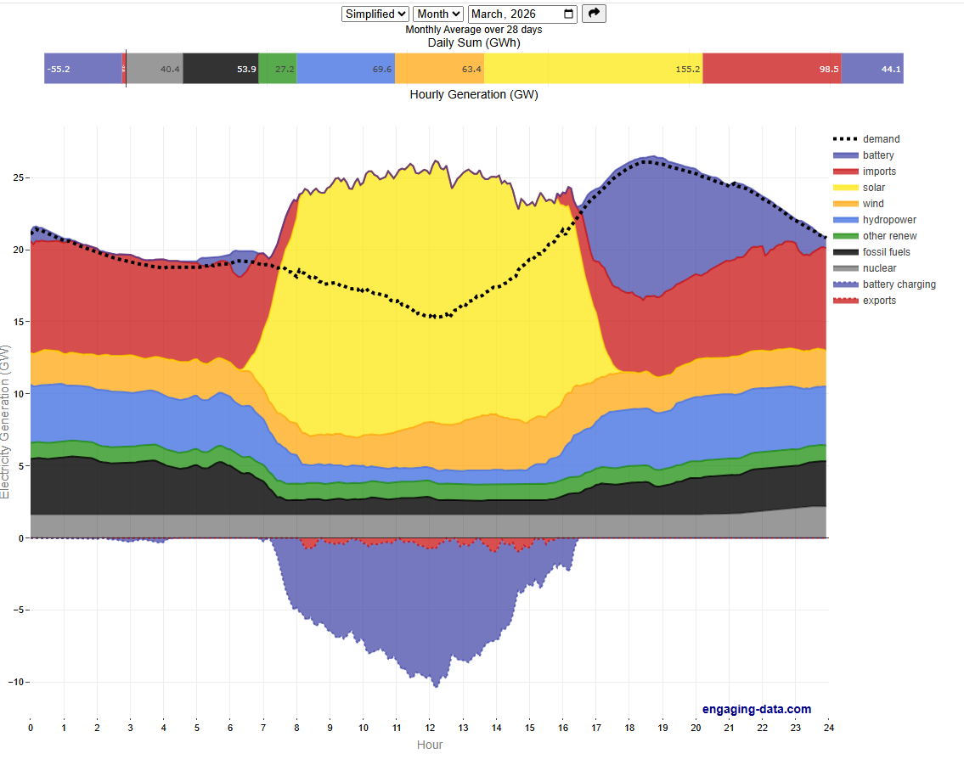

Slide 16
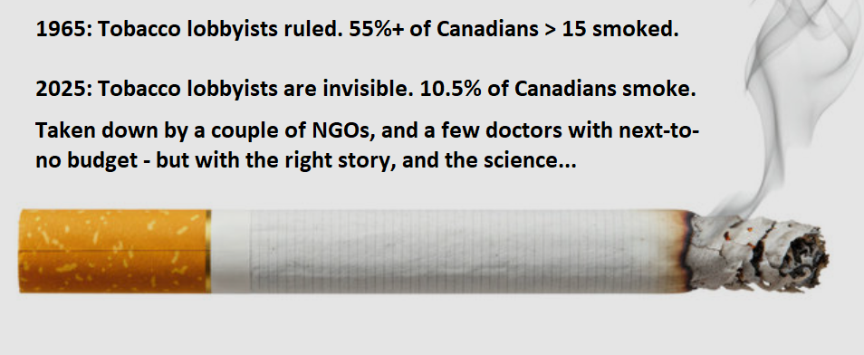
Can we win? Absolutely!
Here’s what gives me confidence:
Proof we can win… with the right story – and the science!
Bonus – we can position ourselves for greater personal prosperity – and offer Canada a future that will serve our children and grand-children.

Slide 17
So… How do we win – and improve our businesses at the same time?
We stop letting the fossil fuels industry soak up all the oxygen in the room (i.e. favourable policies and subsidies, public opinion)
How? By no longer letting them run unopposed
We “Tout our Clout”! We partner with every other member of the clean economy to elevate our clout, because with a combined GDP contribution of 200++ billion, we actually matter more! More in 2026 – much much more in 2036!

Slide 18
So… How do we win – and improve our businesses at the same time?
We lobby hard for our share of support from governments across the country for policy change: Stronger building codes, not weaker, Pushing to net zero… Cheaper mortgages AND higher eligibility percentages for net zero homes
We lobby hard for programs that will benefit both Canadians AND aligned clean economy sectors – and help meet climate commitments (e.g. incentives for energy efficiency retrofits, net zero homes, rooftop solar or wind, EVs)

Slide 19
So… How do we win – and improve our businesses at the same time?
We explain reality to Canadians:
  “The ONLY prosperous future we can have in 2040 is the one driven by a home-grown clean economy”
We reassure them, by demonstrating we already have 1,000s of successful businesses and over 700K jobs.

Slide 20
Looking for Partners…
So… IF we get a higher price on carbon pollution, how do builders win?
Property owners are:
Incentivized to do energy efficiency retrofits
Incentivized to build low carbon from the outset
Incentivized to create net zero homes
Incentivized to electrify

Slide 21
Looking for Partners…
So… If that happens, who else wins when builders do?
Clean tech manufacturers / installers / servicing companies
Rooftop / Balcony solar providers / Renewable energy providers
Electricity delivery companies
Consultants / Architects / Engineers across the space
Low carbon materials vendors (lower carbon cement → tall timber)
EV vendors and EV charging companies / installers
Property owners!! All Canadians win: Homes that are healthier – quieter - and less expensive to run.

Slide 22
Under Threat: Since Carney has come to power, his government has:
cancelled the consumer carbon tax
ditched the proposed cap on oil and gas sector emissions
repealed the electric vehicle sales mandate
struck a deal with Alberta that opens the door to another pipeline, eases methane and carbon limits, supports CCUS
Defunded energy efficiency retrofits

Slide 23
Under Threat: Since Carney has come to power, his government has:
Under Consideration
(and VERY BAD FOR US)
Hold or reduce industrial carbon tax
Make building code less onerous

Slide 24
How do we fight that and get the policies we want? And that benefit our businesses?
Call your MP, MPP, MLA, Councillor and every cabinet minister you can think of!!
They actually pay attention to those calls!!
Email all of those people as follow ups
Low cost – but powerful
Engage your teams in doing the same…

Slide 25
How else do we fight that and get the policies we want? And that benefit our businesses?
Partner with others – especially aligned industries
We LOBBY HARD!
Have your organization Join CanCIA
  Canadian Clean Industry Alliance

Slide 26
It’s Time…
A call to action

Slide 27
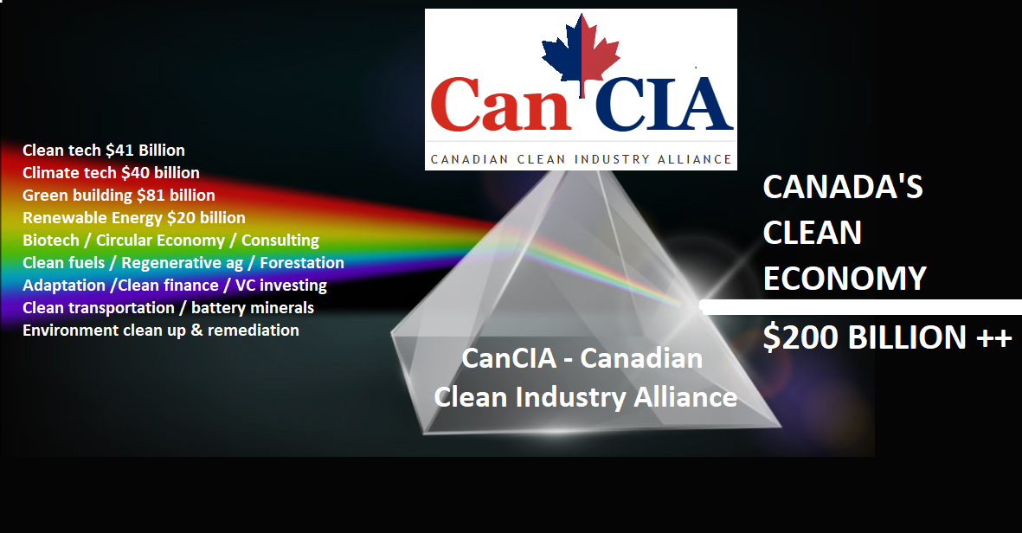
An invitation to collaborate with other groups and turn our growing economic might into policies and programs that can help us grow!

Slide 28



